Slide 1

Introduction to Infrastructure as Code and Azure Resource Manager
Azure UAE Meetup
Feb’19
Owais Ahmed
Cloud Solutions Architect
Halian

Slide 2
“A good Admin is a lazy Admin”

Slide 3

What is Infrastructure as Code (IaC)
Build the infrastructure for an App all at once through automation
Not just for Cloud, Software Defined Data Center
Source Control
Flexible Build Process

Slide 4

Why do IaC?
Less errors
Faster to deliver
Test in production-like environments
Provision multiple environments
Practice deployments
Deliver stable environments

Slide 5



How to Get Started
People
Process
Products
Have a Vision
This is a big change
IaC/DevOps Movement
A way of life
Required to be successful
Simplicity
Modular
Flexible
Versioning
Powershell/Bash
Azure ARM Quickstart Templates
VS Code
GitHub
Azure Automation, Terraform, Azure DevOps

Slide 6

Steps to Implement IaC
Find something easy to automate – low effort, low risk
Set the right expectations – experimentation is necessary
Prove that it works – show the time savings and effort needed
Do it again

Slide 7
“Opportunities”
Be thorough – identify all the steps
Expect manual steps within process
Ctrl-C & Ctrl-V
Desired State Configuration
Buy vs. Build
Service Portal or Manual Start

Slide 8

Introduction to Azure Resource Manager

Slide 9
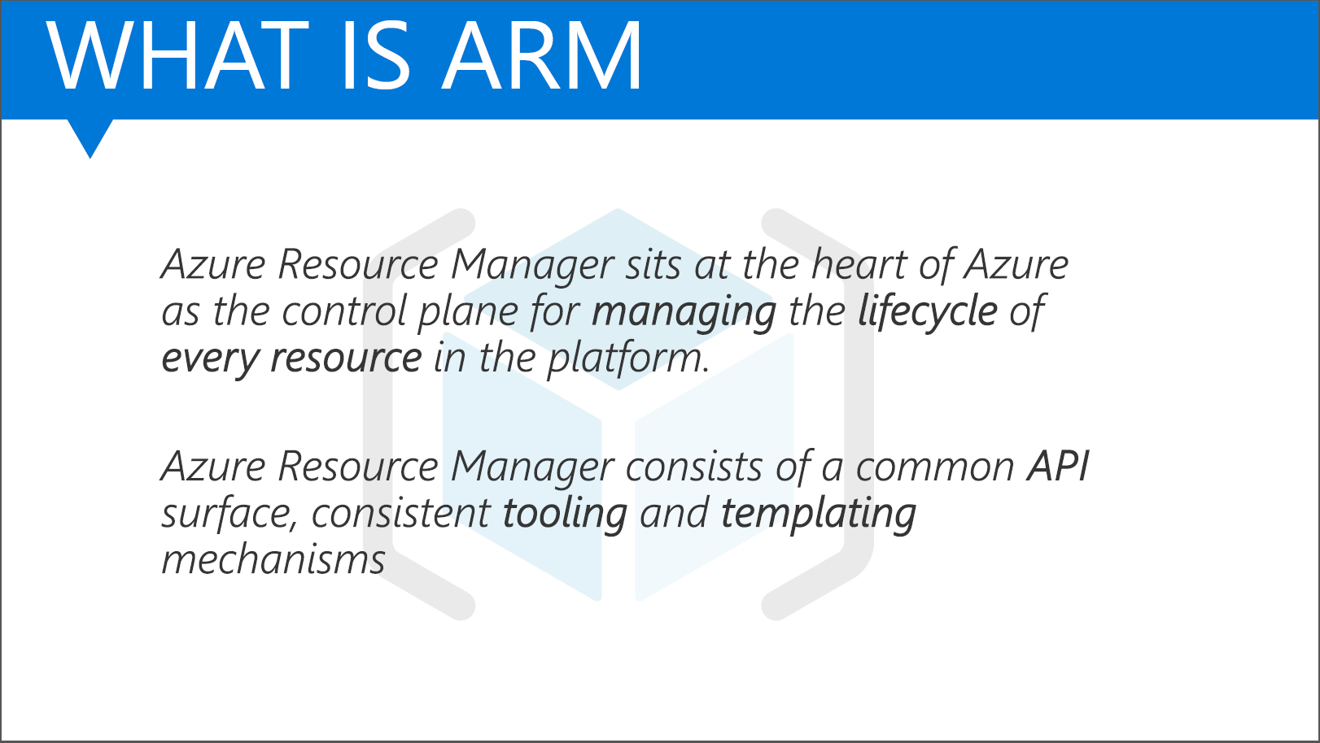

Slide 10



















What is Azure Resource Manager?
….
Clients
AZURE MANAGEMENT SDKs
HTTPS API endpoint (management.azure.com)
ARM Service
RESOURCE Activity logs
RESOURCE Lock ENFORCEMENT
Deployment ENGINE
ROLE Based Access control
policy ENFORCEMENT
Resource group MANAGEMENT
RESOURCE EVENT SOURCE
RESOURCE Provider Contract (RPC)
….
Resource
Providers

Slide 11
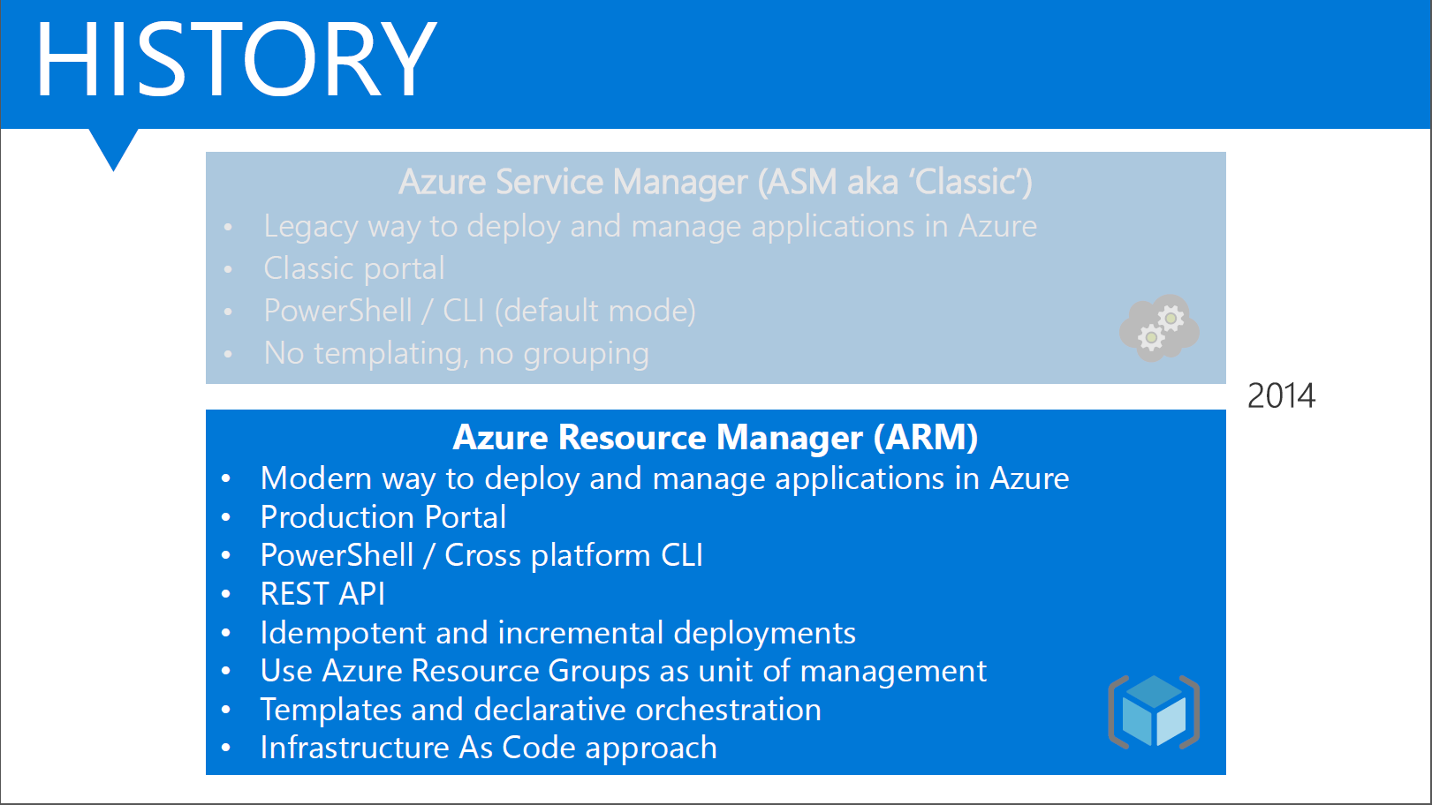

Slide 12
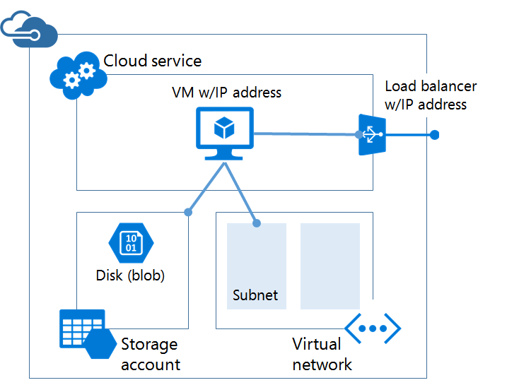
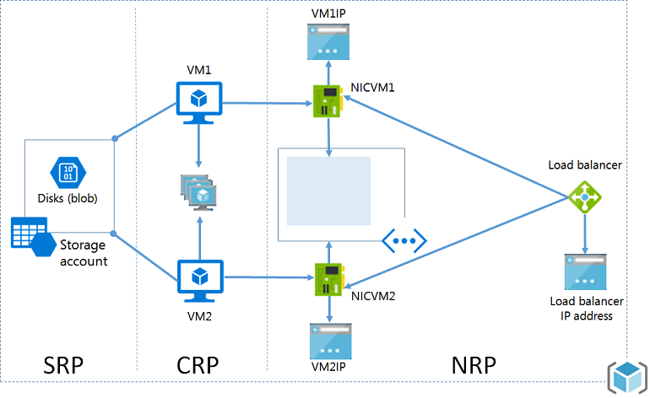
Azure Resource Manager
Classis (ASM)
ARM with RPs

Slide 13
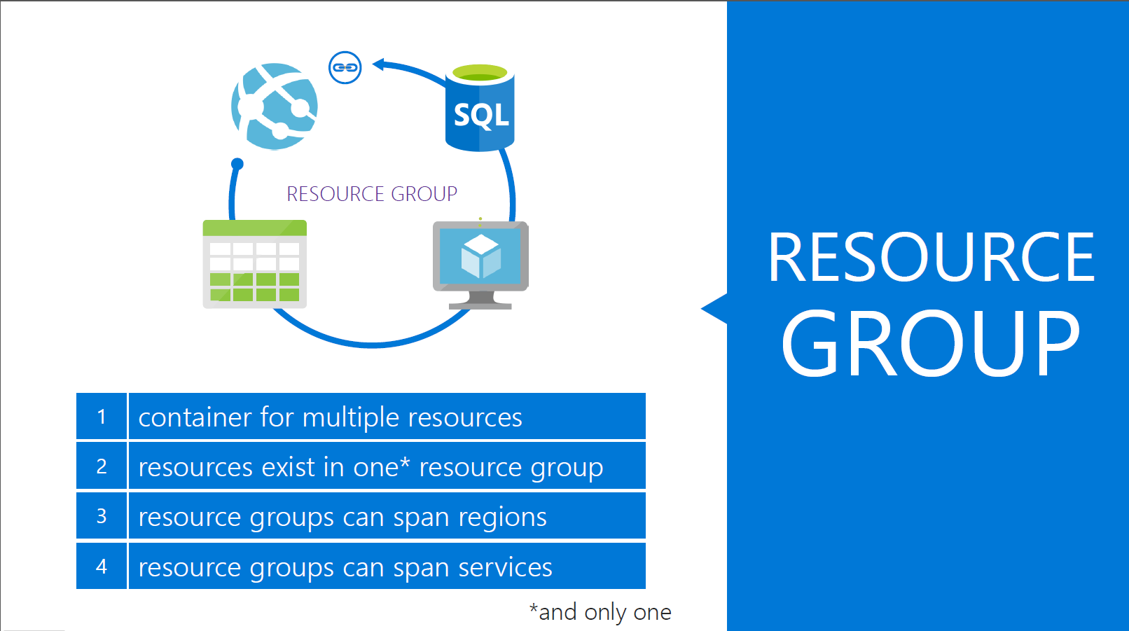

Slide 14
Resource Group Lifecycle
Question:
Should these resources be in the same group or a different one?
Hint:
Do they have common lifecycle and management?
Answer:
Up to you.

Slide 15
Immutable and declarative scenarios
Tooling/Automation, Service request
CI/CD, Production and non-production scenarios
Considerations for declarative implementation
Multi-cloud
IaaS and Containers
ARM templates / automation
Team background/knowledge and familiarity
Requirements (short term, long term)
Lift and shift
How to achieve declarative in Azure?
Templates! “It depends”!
Azure (Sub\RG)
Related – Not in Azure
Terraform OSS RP
The resource
The resource(s)
Resource control plane vs data plane or “Resource last mile”
IaaS – In-guest configuration
Containers – helm script
SaaS

Slide 16
ARM Templates
Azure’s IaC solution

Slide 17
Power of Repeatability
SQL-A
Instantiation of repeatable config.
Configuration → Resource Group
Azure Templates can:
Ensure Idempotency
Simplify Orchestration
Simplify Roll-back
Provide Cross-Resource Configuration and Update Support
Azure Templates are:
Source file, checked-in
Specifies resources and dependencies (VMs, WebSites, DBs) and connections (config, LB sets)
Parametized input/output
Website
[SQL CONFIG] VM (2x)
DEPENDS ON SQL
DEPENDS ON SQL
SQL - A
Website
Virtual
Machines
SQL
C
ONFIG

Slide 18
Add your own Power
Some resources can be extended allowing more code or data inside the resource
AV agent inside a VM
WordPress Webdeploy package on a Website
Allow for Scripting or Imperative configuration of resources
Extensible solution (Windows and Linux):
DSC (in-VM PowerShell)
Chef
Puppet

Slide 19
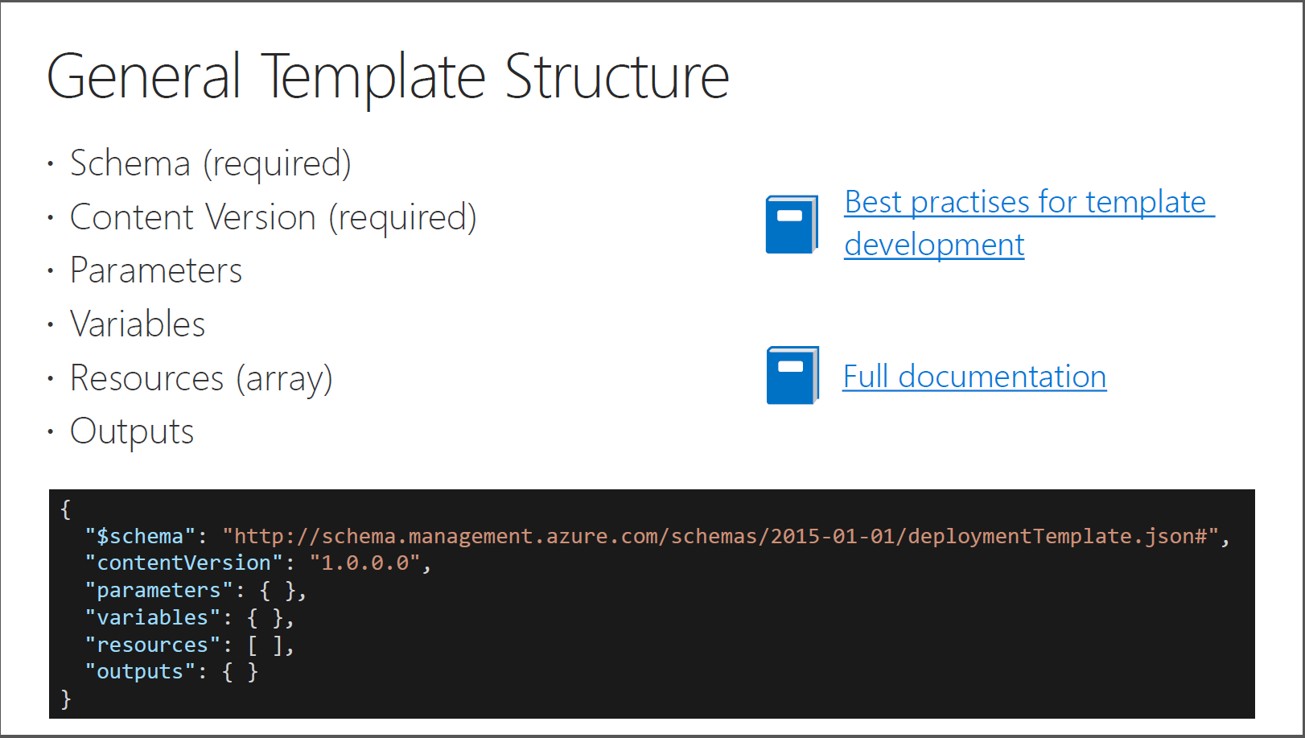

Slide 20
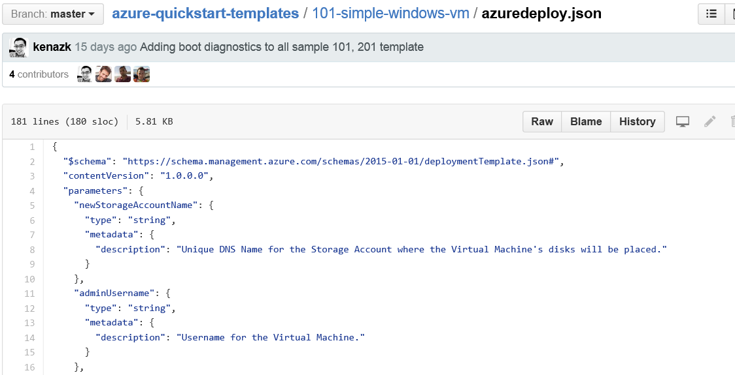
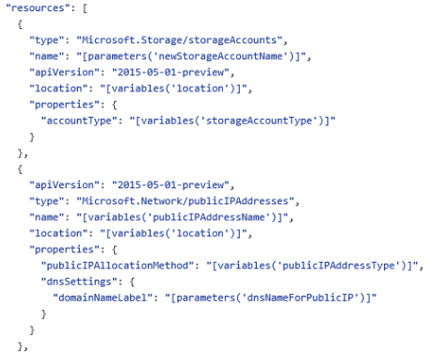
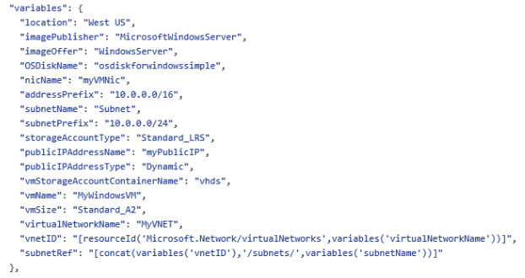
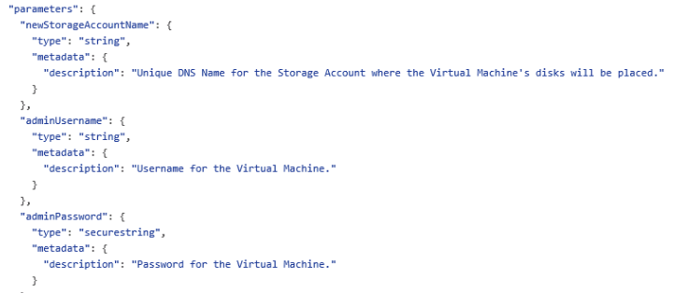
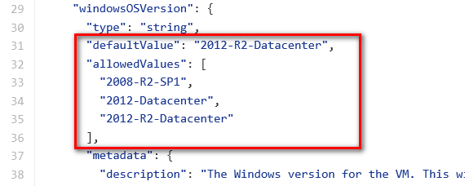
JSON files—simpler than they look Schema, content version, parameters, variables, resources, and outputs
Notes:
A JSON template file is a text file that contains descriptions of the resources, configurations code and extensions. JSON templates are idempotent, which means that they can be run multiple times without changing the outcome beyond initial deployment. A consequence of this characteristic is that templates can be used to upgrade applications, for example, by scaling out applications with additional VMs. You modify the template to include the specifications for the additional virtual machines. When you deploy the template, Azure Resource Manager will recognize the resources that have previously been deployed and create only the resources that have been added.
A JSON template is divided into sections:
<CLICK> The $schema (a required element that provides the location of the file that describes the version of the template language) along with a required element that provides the version of the template
The schema reference is used by intelligent JSON clients to determine the schema that is applicable to the JSON file and to provide additional functionality such as autocomplete and intellisense.
<CLICK> Parameters (optional elements that define values that are passed in when the template is executed)
The value for the Parameters key is an array of parameter objects that representing the dynamic input for the JSON template. Each of the parameter objects has a name that is used pass values in at runtime and is referenced within the JSON itself in other sections. For example, "NewStorageAccount" is the name of the parameter that is supplied as an input and used to provide the name of the storage account resource specified in the JSON file.
<CLICK> Variables (optional elements that define the values that are used when template is executed)
<CLICK> Resources (a required element that defines the resources that are deployed or updated in a resource group); and
This slide doesn’t show it, but you can also have an optional Outputs section that defines values that are returned after a deployment
<CLICK> A JSON file is constructed of key/value pairs. For example, in the image above, "ContentVersion" is the key and "1.0.0.0" is the value. A key is always a string enclosed in quotation marks. A value can be a string, securestring, number, boolean expression, array, or object. A JSON object is enclosed in curly braces, "{ }". In a key/value pair the key is always followed by a colon. Key/pairs are separated by commas.
A JSON template may also contain functions and expressions. Expression are enclosed in square brackets, "[ ]', and can appear anywhere in a JSON string. Functions calls have the format functionName(arg1,arg2,arg3). Properties are referenced using the dot and index operators.
The lab provides notes with additional details regarding specific parameters, variables, resources, etc.
Authoring Azure Resource Manager templates
https://azure.microsoft.com/en-us/documentation/articles/resource-group-authoring-templates/

Slide 21
Passing state—common parameters
Name (string values) | Description
Location | The location where the resources will be deployed from a constrained list of Azure regions
storageAccountNamePrefix | Unique DNS name for the storage account where the VM’s disks will be placed
virtualNetworkName | For deployments that create a new virtual network, the name to use for creating that resource. For deployments that use an existing virtual network, the name of the VNet to deploy into
username | User name for the virtual machine(s) and potentially the application(s). More than one user name can be requested from the end user, but at least one must be prompted
password | Password for the virtual machine(s) and potentially the application(s). More than one password can be requested from the end user for different VMs or applications, but at least one must be prompted
Size | The named scale unit size to provision from a constrained list of offered sizes For example, “D2v3”, “Standard S1”, “Premium”

Slide 22
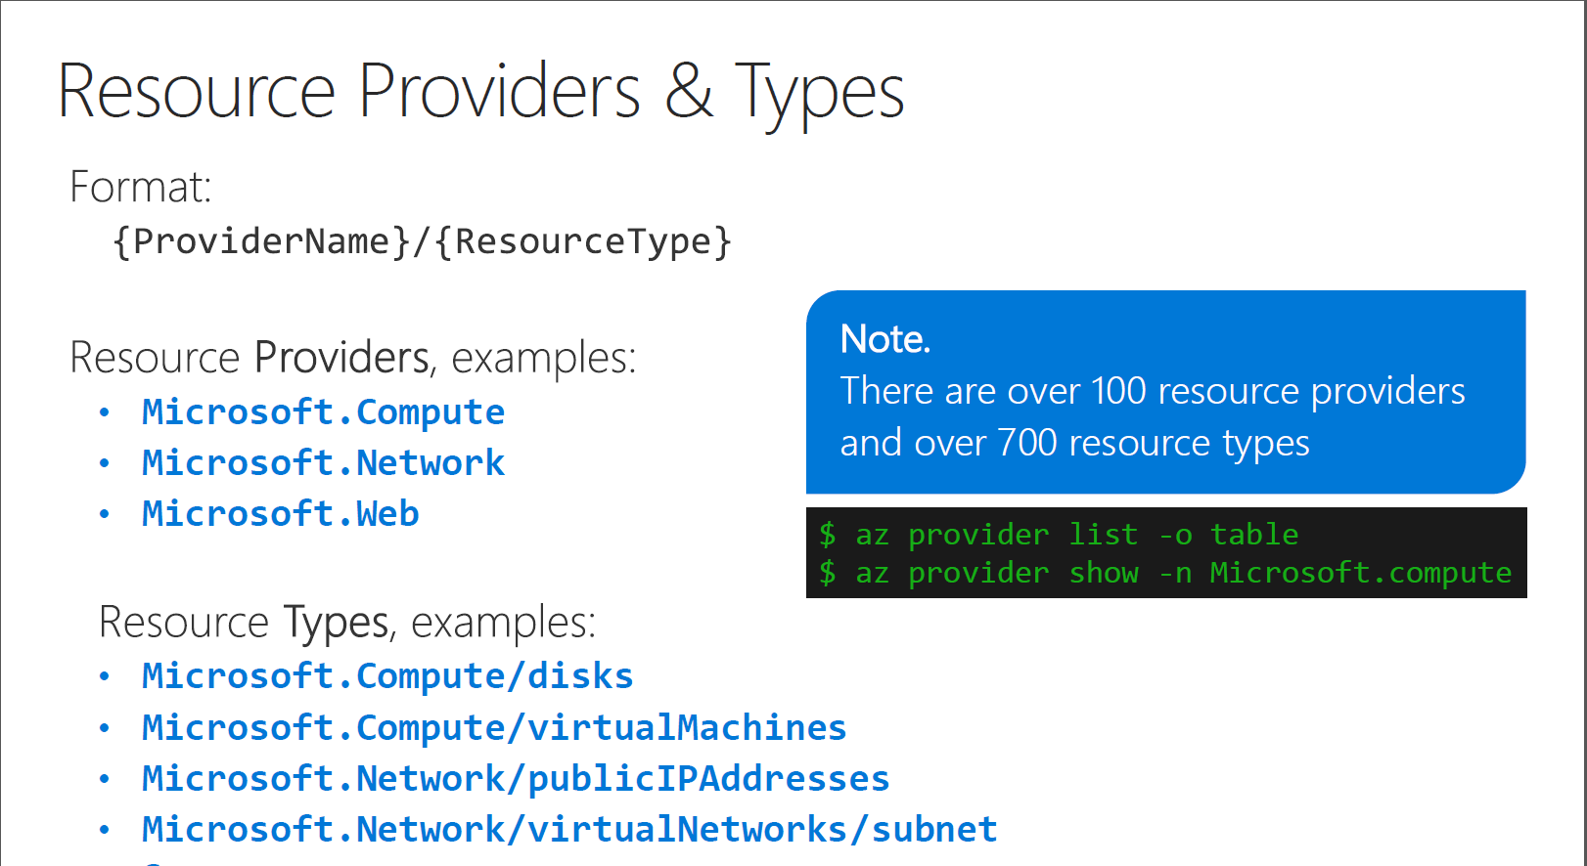

Slide 23
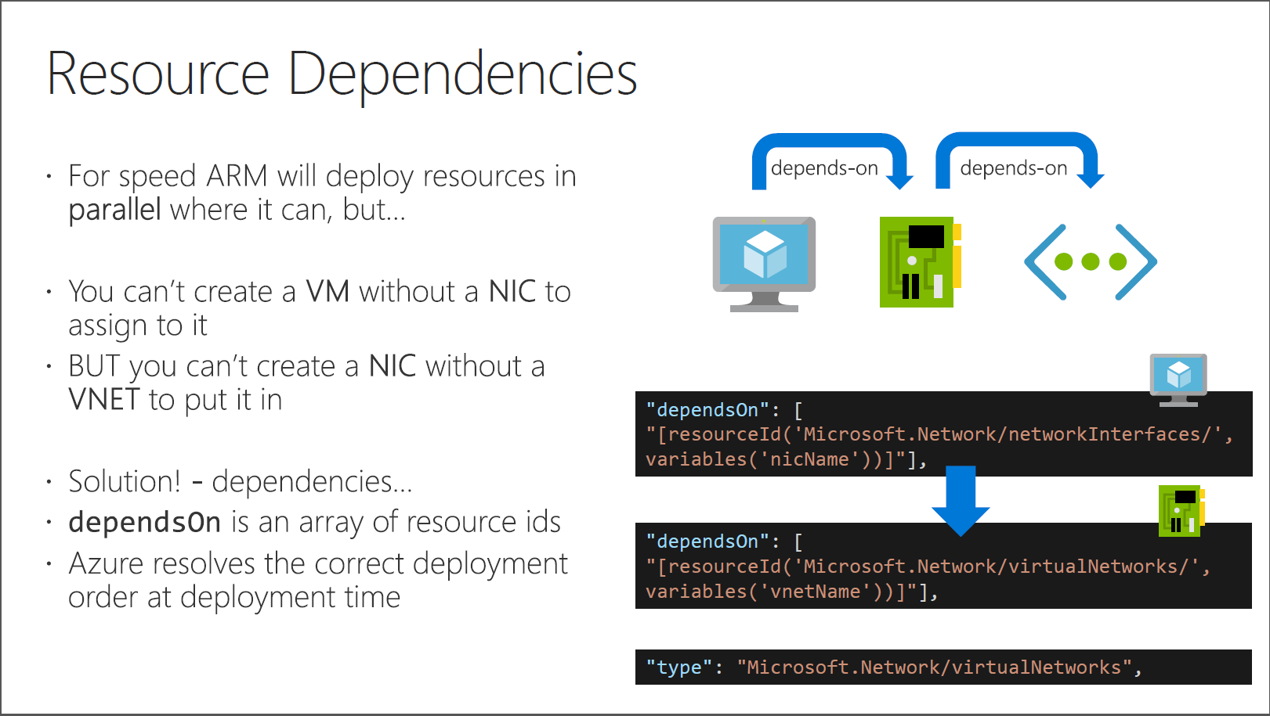

Slide 24
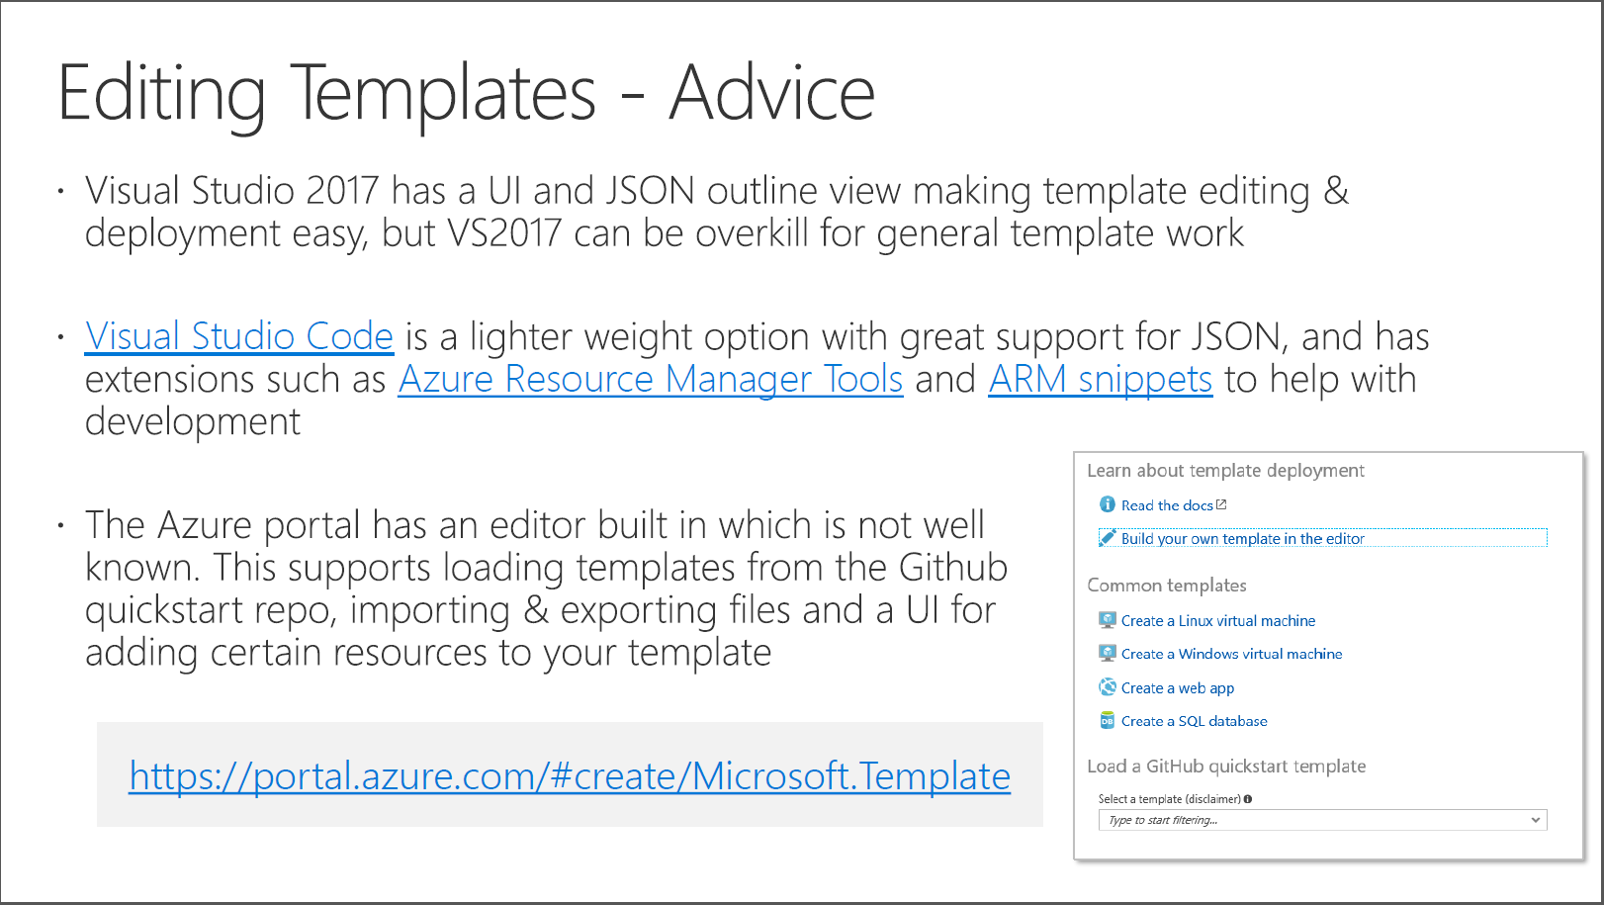

Slide 25
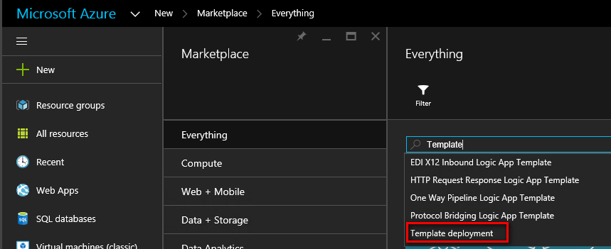
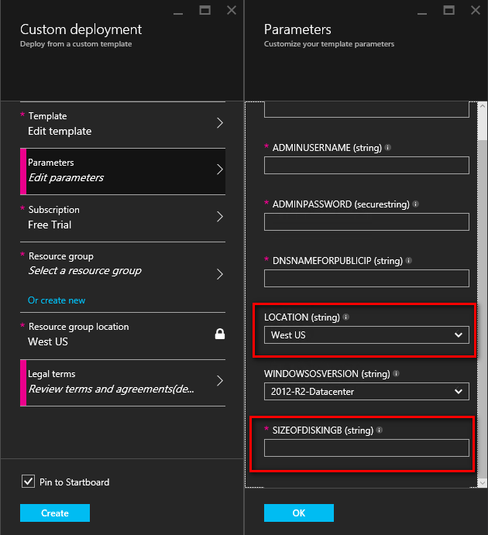
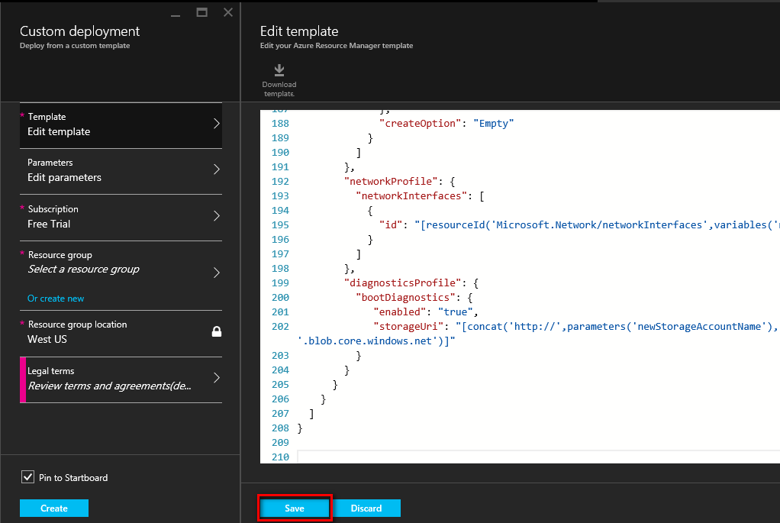
Deploying custom JSON files
New-AzureResourceGroupDeployment -DeploymentName "Simple-VM" -ResourceGroupName RG-AZITCAMP -TemplateFile "C:\GitHub\Templates\101-simple-windows-vm\azuredeploy.json
Notes:
The Lab walks through this process from start to finish
Deploy an application with Azure Resource Manager template
https://azure.microsoft.com/en-us/documentation/articles/resource-group-template-deploy/

Slide 26
Resources
Quick start templates - https://github.com/Azure/azure-quickstart-templates
ARM full reference http://aka.ms/armref
Azure published templates - https://azure.microsoft.com/en-gb/resources/templates/
Resource explorer - https://resources.azure.com/
Resource Manager main docs - https://docs.microsoft.com/en-us/azure/azure-resource-manager/
ARM template best practices - https://aka.ms/armbest
ARM template main docs - https://docs.microsoft.com/en-us/azure/templates/
Template functions reference - https://docs.microsoft.com/en-us/azure/azure-resource-manager/resource-group-template-functions
Visual Studio Code - https://code.visualstudio.com/
Azure Portal template editor - https://portal.azure.com/#create/Microsoft.Template
ARM Client tool - https://github.com/projectkudu/ARMClient

Slide 27

Get more resources and learn more on
Cloud Infrastructure
Scan QR Code
https://aka.ms/AA4eaxy

